Slide 1
Exchange Student Decision Assistant
Denmark Edition

Slide 2
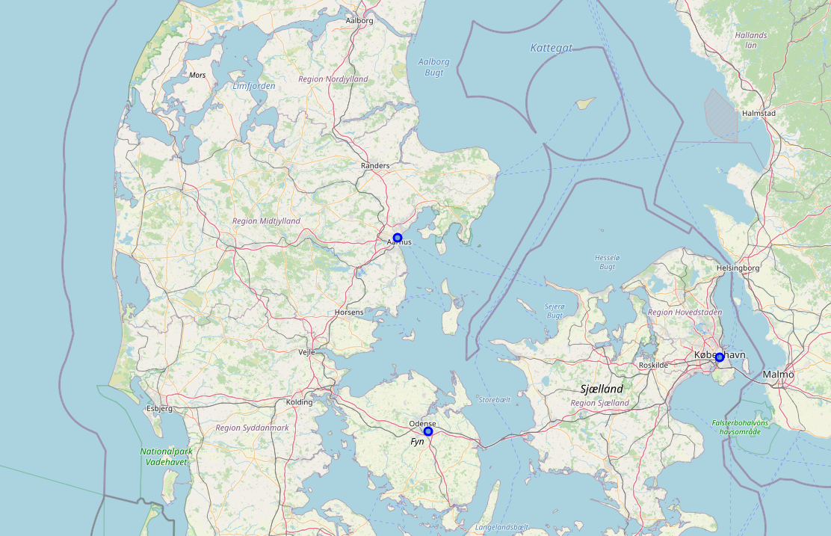
Introduction
The Exchange Student Decision Assistant – Denmark, is a tool created to support aspiring Exchange Students (within Medicine) to select the right University to study at while in Denmark
There are three main universities in Denmark, of equal renown and quality

Slide 3
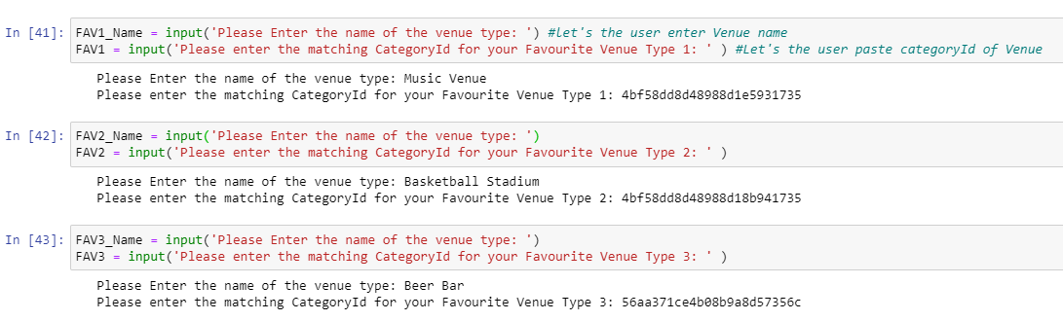
Decision parameters 1/2
Initially you must choose the distance in meters you will like to investigate
Three choices of venues to select from based on the Foursquare API data, you must input the Venue Name and Venue CategoryId

Slide 4
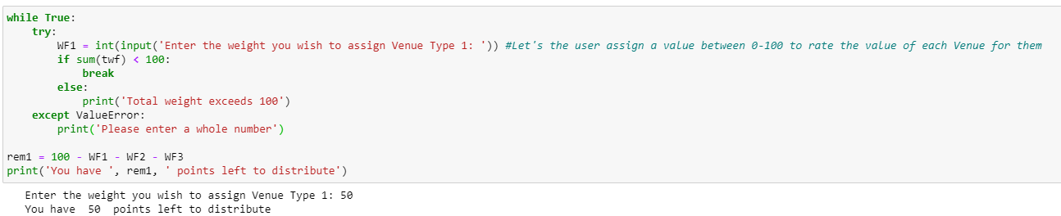
Decision parameters 2/2
Next you will assess each venue in respect to eachother to allow for differentiated weighting of each venue
This is done for all three selected types of venues

Slide 5
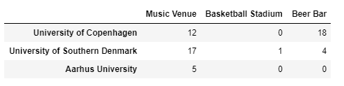
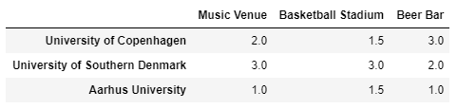
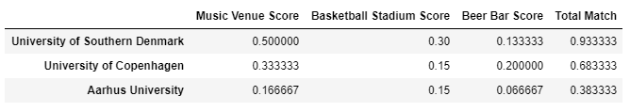
Results
Based on the user-defined input, the Exchange Student Decision Assistant will count, rank and score each university
Count
Rank
Score

Slide 6
Conclusion
Lastly, you will be presented with a conclusion to which University supports your selected interests the most
The ‘Exchange Student Decision Assistant’ is a strong tool for helping exchange students, with no preference or family ties, to decide where in Denmark to study.
For future development of the tool, it should aim to implement ‘geopy’ to let the user select multiple other Universities around the world and compare them to eachother

